Slide 1
Intro to C++
Session - 1
BCHS Jagbots - Team 6518

Slide 2
Topics
What is a computer? And, what is a program?
First C++ program
Errors and debugging
Designing Software

Slide 3
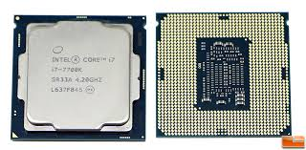
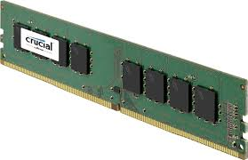
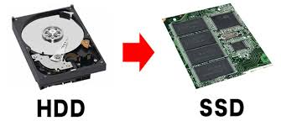
What is a computer?
Electronic device
Processes (raw) data
Generates (meaningful) information
Parts:
CPU
Memory
Storage

Slide 4
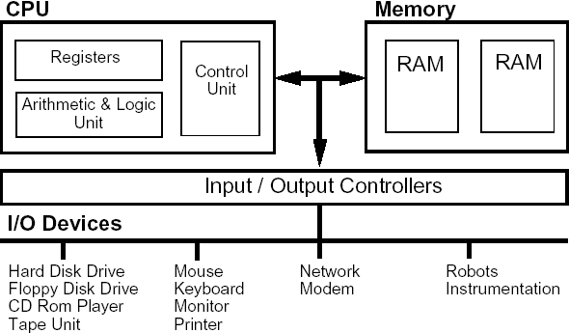
Computer Architecture

Slide 5
What is a program / programming?
Set of steps or “instructions”
“Run” or followed in sequence
Programming: Art and Science of designing and building programs
Activity 1:
Design a program for an electric toaster to evenly toast a slice of bread once it has been turned “on”
OR
Design a program that will catapult a bird from one location to another in a video game.
Now, add wooden structures at the landing site, and enhance the design to cause these structures to collapse if hit with a velocity higher than a threshold

Slide 6
First C++ Program
Demo:
C++ code walkthrough
View preprocessed code
View binary code

Slide 7
How to program in C++
Write the program
Compile it
Link it
Run it
Did it work?
If yes: you are done
If no: troubleshoot till it works
Activity 2:
Where would you store your programs?
How do you prevent your work from getting lost as you write programs?

Slide 8
Your Turn
Start the online IDE
Type in a “Hello, world” program
Compile it
Run it

Slide 9
Errors:
Spot the errors:
Two major types:
Compile time errors
Run time errors

Slide 10
Designing Software
Activity 3:
Cox Internet provides 250GB data/month for $79.99, and $10 for every additional block of 50 GB. On the total amount you pay 13.75% taxes and fees. Design a program in plain English that requests the data consumed in a month in GB, and tells you your monthly charge

Slide 11
Problems

